Slide 1

Intro to computational neuroscience
Dr Eran Shorer
March 2022
Neurophysiology Honours
University of Cape Town
Notes:
Point of this talk is not really to teach you anything but more to indohelp you understand what is computational neuroscience and what are models

Slide 2
10¹² Neurons
10¹⁵ Synapses
A single dendrite of a mammalian motor neuron can receive 10⁴ synapses
Variations across time and space
Notes:
These connections aren’t stable in time and space.

Slide 3
The brain computes
Receives sensory input encoded as changes to membrane potentials or firing rates
Performs operations on these (mathematical function) / transforms input signals
Outputs is stored and used to impact behaviour of an animal

Slide 4
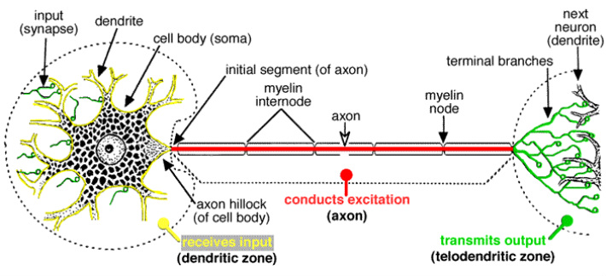




Notes:
Computational neuroscience - Latest research and news | Nature

Slide 5
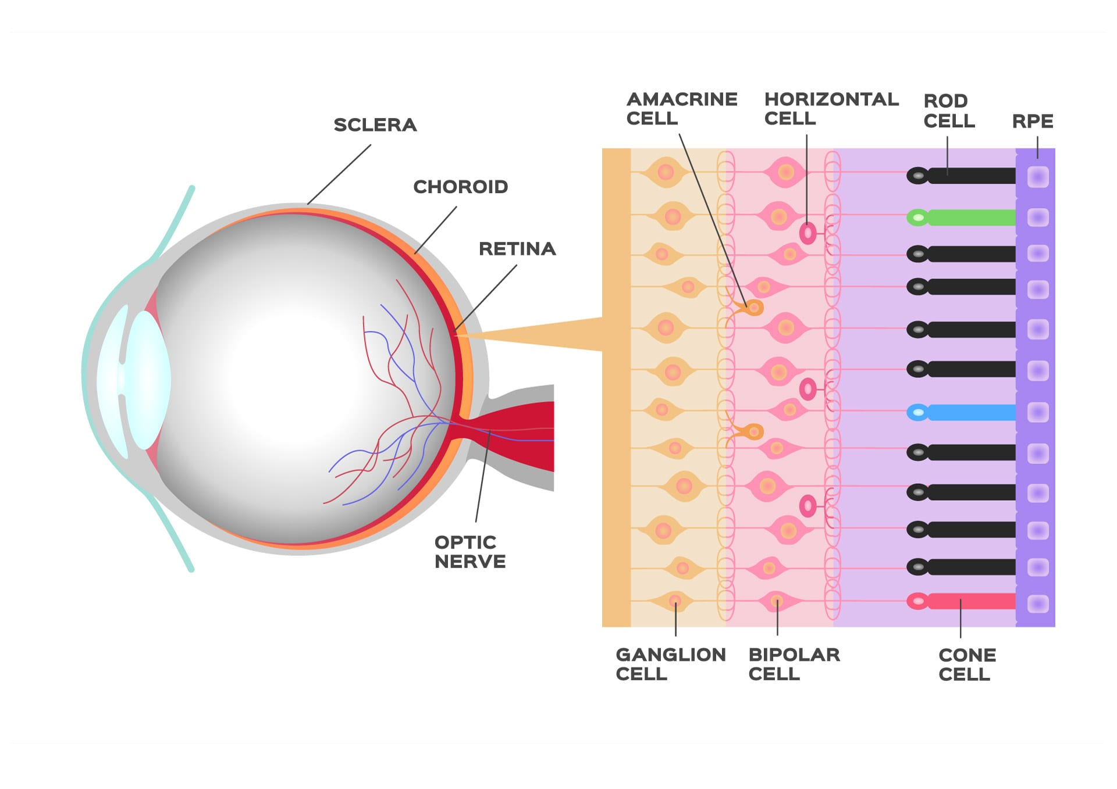
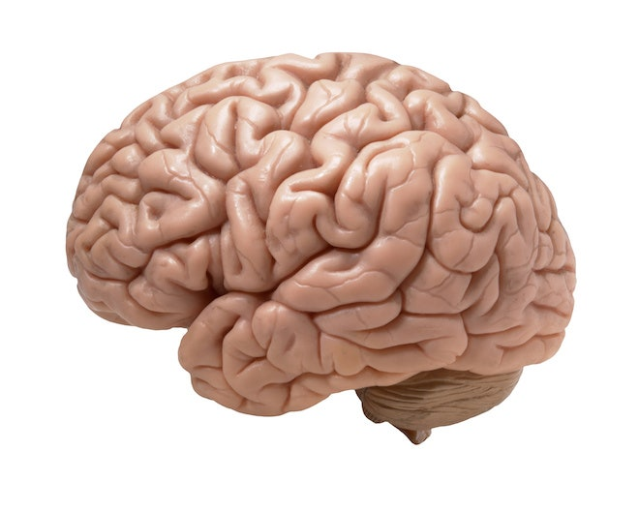


voltage changes in retinal cells
f(x)
Perception
Notes:
Some transformations may be addition/subtraction
Some are more complicated like filtering and amplification
AND/OR/XOR.

Slide 6
Why do we need to know how the brain computes
Understand the brain (who and what we are)
Understand and treat neurological and psychiatric disease
Applying methods of how the brain computes to other systems
Notes:
– understanding the differences between processing in healthy and disease states can lead to new treatments (e.g. Deep Brain Stimulation & cochlear implants)
The brain uses 20 Watts to perform its functions.
Modern CPUs require far more energy to perform the same calculations

Slide 7
What is Computational Neuroscience?
“Computational neuroscience is the field of study in which mathematical tools and theories are used to investigate brain function. It can also incorporate diverse approaches from electrical engineering, computer science and physics in order to understand how the nervous system processes information.”
Also referred to as Theoretical Neuroscience or Mathematical Neuroscience
Notes:
Computational neuroscience - Latest research and news | Nature
Computational Neuroscience is a sub specialization of theoretical neuroscience which uses computers to create models, also putting more emphasis on the computational aspect of analysis

Slide 8
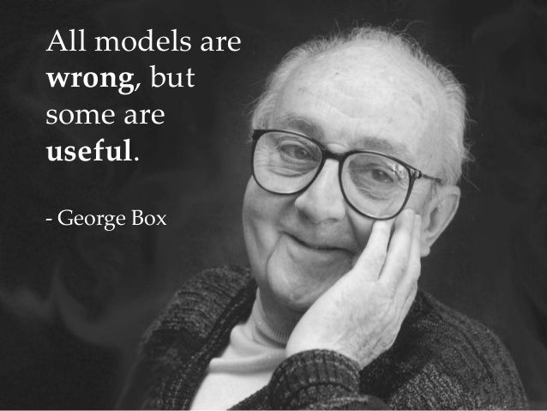
What is a model?
A model is an abstraction of a real world system
Considered a quantification of a hypothesis used to investigate it
Notes:
Trappenberg Textbook.
A hypothesis is different to a model.
A model is used to investigate a hypothesis.
In neuroscience you may have a hypothesis at different scales
Hypo: The aesthetics of the city will be great with parks at the edges. Model: small scale construction to get a first impression of the look. Might not be able to test the structural integrity of the small houses in a hurricane, but you can test how the colour scheme of the buildings will suit the environment.
Hypo: Anions in neurons don’t change the electrical properties of neurons. Model: computational construction of a neuron. Cant say what the effect of this on consciousness or memory.
In computational neuroscience we use computers to create models.
The results of these models are often compared to experiment

Slide 9
Facts:
Neuroanatomy
Neurophysiology
Neuropsychology
Physics principles
Hypothesis
Model
Theory
Tools:
Non-linear dynamics
Graph Theory
Information Theory
Statistics
Machine Learning
Computational resources:
CPU/GPU speed
Memory
Notes:
Development of new questions
Refinement of models
Parameter tuning
Adapted from Trappenberg

Slide 10
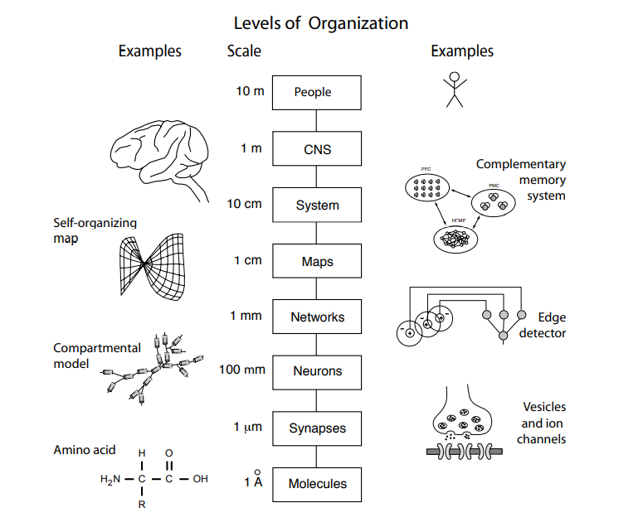
Notes:
From Trappenberg et al. pg4
1 angstrom is 1e-10 meters

Slide 11

Notes:
Alphafold from google’s deep mind

Slide 12
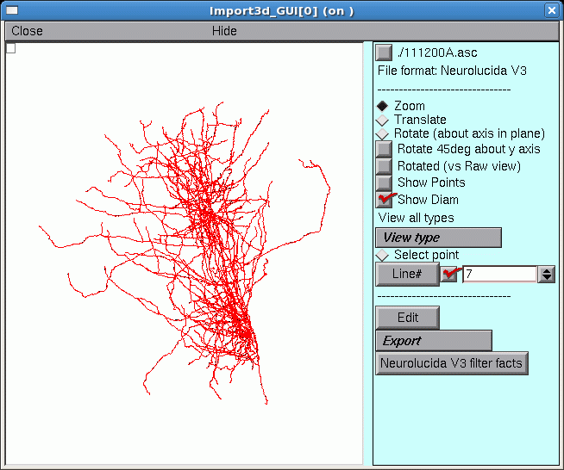
Notes:
NEURON

Slide 13
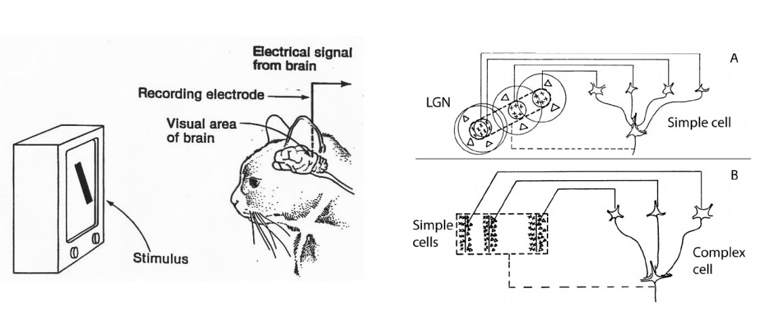
Hubel and Weisel experiment
Notes:
Professors David Hubel and Torsten Wiesel have experimented in the 1950s wherein they recorded the neuronal activities of the cat across the retina, as they moved a bright light. They’ve filed a few exciting observations while the experiment was going on, they are
Neurons fired only in some instances, but not always.
The activity of neurons changed depending on the orientation and location of the line of light.
(Don’t worry about the neuronal jargon, we would be exploring all the terms in the following topics.) The electrical and chemical signals recorded in the cells connecting the retina to the brain were converted to sound signals. These sound signals were then played, which resulted in ‘Snap! Pop!’ crackling sounds. These weren’t continuous, instead played only when the neuron fired. Henceforth, it has established a fundamental understanding of how neurons extract the information cast by the retina, and then clearly explained how the visual cortical neurons (present in the primary visual cortex, V1, in the brain) can formulate an image.

Slide 14

Notes:
Professors David Hubel and Torsten Wiesel have experimented in the 1950s wherein they recorded the neuronal activities of the cat across the retina, as they moved a bright light. They’ve filed a few exciting observations while the experiment was going on, they are
Neurons fired only in some instances, but not always.
The activity of neurons changed depending on the orientation and location of the line of light.
(Don’t worry about the neuronal jargon, we would be exploring all the terms in the following topics.) The electrical and chemical signals recorded in the cells connecting the retina to the brain were converted to sound signals. These sound signals were then played, which resulted in ‘Snap! Pop!’ crackling sounds. These weren’t continuous, instead played only when the neuron fired. Henceforth, it has established a fundamental understanding of how neurons extract the information cast by the retina, and then clearly explained how the visual cortical neurons (present in the primary visual cortex, V1, in the brain) can formulate an image.

Slide 15

Notes:
Professors David Hubel and Torsten Wiesel have experimented in the 1950s wherein they recorded the neuronal activities of the cat across the retina, as they moved a bright light. They’ve filed a few exciting observations while the experiment was going on, they are
Neurons fired only in some instances, but not always.
The activity of neurons changed depending on the orientation and location of the line of light.
(Don’t worry about the neuronal jargon, we would be exploring all the terms in the following topics.) The electrical and chemical signals recorded in the cells connecting the retina to the brain were converted to sound signals. These sound signals were then played, which resulted in ‘Snap! Pop!’ crackling sounds. These weren’t continuous, instead played only when the neuron fired. Henceforth, it has established a fundamental understanding of how neurons extract the information cast by the retina, and then clearly explained how the visual cortical neurons (present in the primary visual cortex, V1, in the brain) can formulate an image.

Slide 16
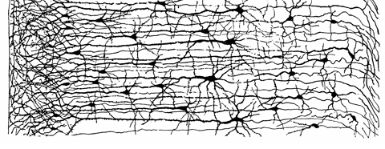
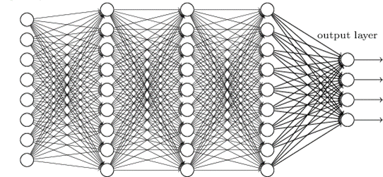
Real Neural Network
Artificial Neural Network
Notes:
Perceptron

Slide 17
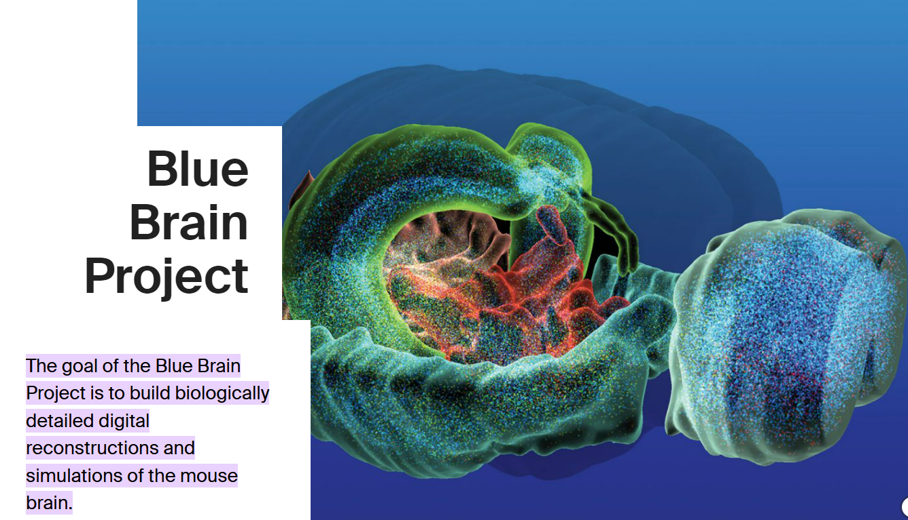
Notes:
One of the most ambitious projects in computational neuroscience is the blue brain project attempting to create a morphologically realistic model of an entire mouse brain

Slide 18
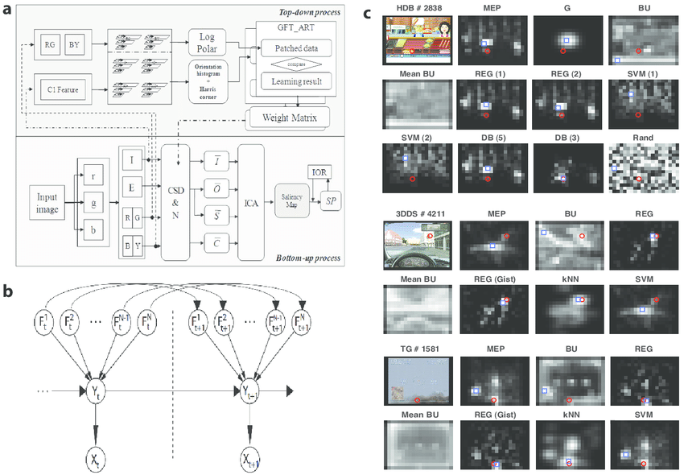
Notes:
Computational models of attention

Slide 19
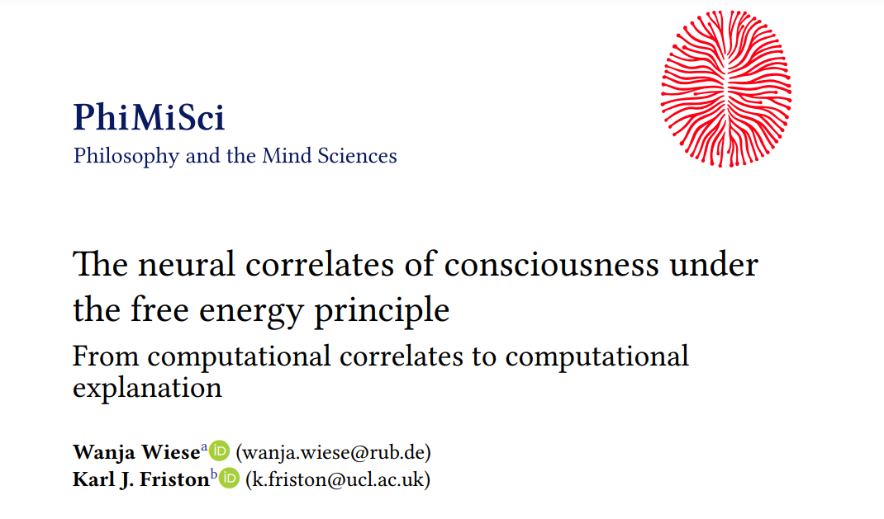
Notes:
Models of esoteric subjects

Slide 20
Marr’s - Levels of Analysis
“What nervous systems do”
→ Descriptive
“How do nervous systems function”
→ Mechanistic
“Why do the nervous system operates in particular ways”
→ Interpretive
Notes:
From Trappenberg et al. pg4
Coursera UW week 1computational neuroscience course

Slide 21
Descriptive models
“What” → Descriptive
Given a large amount of experimental data can we fit a model to describe a phenomena
Is there some sort of pattern in the data?
E.g. Hubel and Weisel experiment
Notes:
A Brief Introduction to Computational Neuroscience Part 1 | by Samhita Alla | Towards Data Science
Explaining a phenomenon – NOT describing
Try capture a phenomenon of interest
Neural encoding – given a stimulus what is the neural firing pattern
Neural decoding – given a neuron firing pattern what is the stimulus
Models and theory | INCF TrainingSpace

Slide 22
Mechanistic models
“How” → Mechanistic
With the known anatomy, physiology and circuitry
How do we simulate the behaviour of a single neuron or network of neurons
E.g. identifying the equations which govern neural dynamics such as in Hodgkin Huxley experiments
Notes:
A Brief Introduction to Computational Neuroscience Part 1 | by Samhita Alla | Towards Data Science

Slide 23
Interpretive models
“Why” → Interpretive
Using information-theory principles, identify why brains operate the way they do
What are the computational principles underlying them.
Notes:
A Brief Introduction to Computational Neuroscience Part 1 | by Samhita Alla | Towards Data Science

Slide 24

Modelling philosophy
A more detailed model is not necessarily superior
Need to be detailed enough to provide information to the lower level
Need to be simple enough to provide information to the higher level
Notes:
Dayan and Abott

Slide 25
Summary
Understanding of the computations occurring in the brain
Building mathematical models.
Building computational tools to process neuroscience data

Slide 26
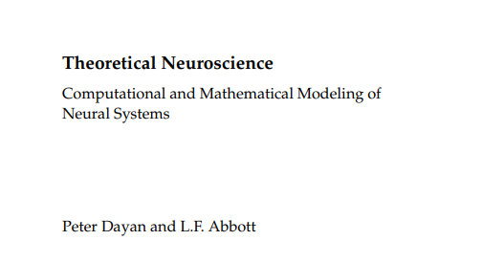
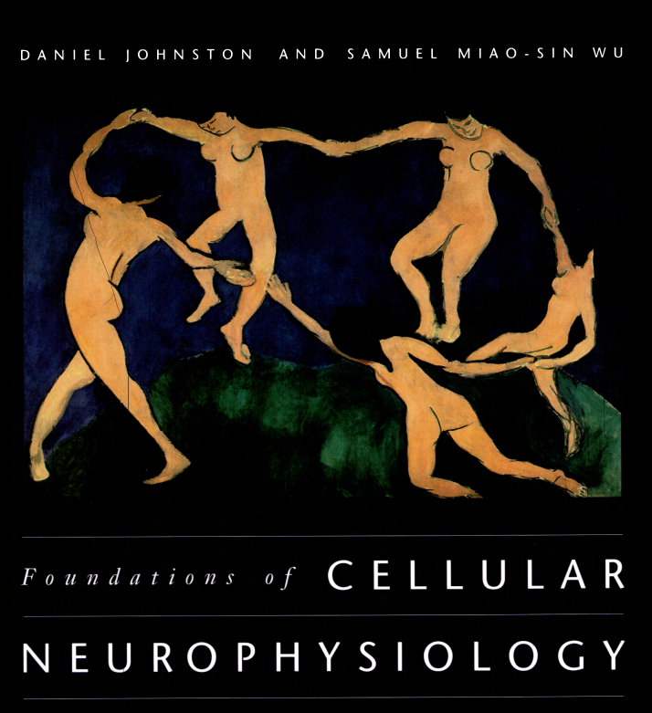
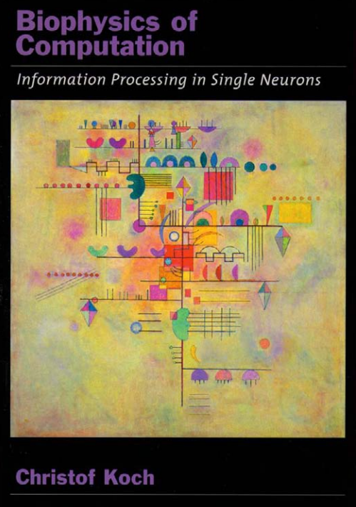
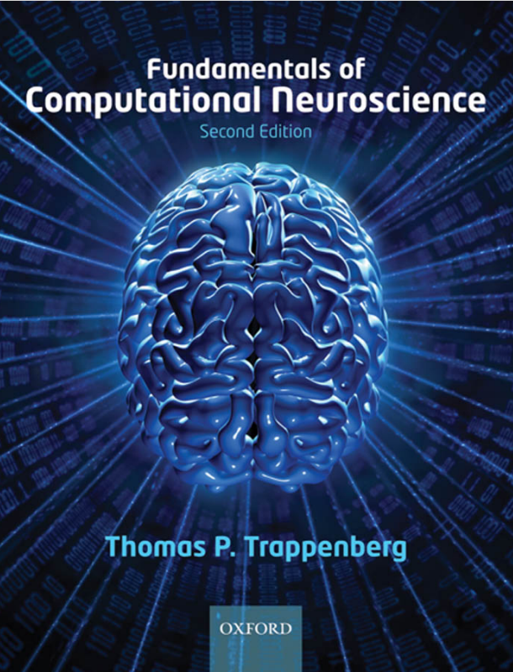
Learn more

Slide 27


Learn more
Notes:
What is Computational Neuroscience? Definition & FAQs – EMOTIV
Models and theory | INCF TrainingSpace

Slide 28
Confusing Neuro “Mumbo-jumbo” (part 1 / 1 000 000)
Complex system - a system whose overall behavior can be characterized as more than the sum of its parts
Emergence - the way complex phenomena arise from a collection of relatively simple interactions between system components
Reductionism - a view that a complex system can be modeled and understood simply by reducing the examination to a study of the system’s constituent parts
Phenomenology - the study of consciousness and the objects of direct experience.
Connectome - a complete connectivity map of a system. In neuroscience, the structural connectome is defined by the anatomical connections between subunits of the brain whereas the functional connectome is defined by the functional relations between those subunits.
Tuning – Choosing optimal parameters for a learning algorithm.
Notes:
Understanding complexity in the human brain (nih.gov)

